Slide 1


Zharin Dinchev
21.04.2024

Slide 2

Outline
Executive Summary
Introduction
Methodology
Results
Conclusion
Appendix

Slide 3
Executive Summary
Summary of methodologies
Data Collection through API
Data Collection with Web Scraping
Data Wrangling
Exploratory Data Analysis with SQL
Exploratory Data Analysis with Data Visualization
Interactive Visual Analytics with Folium
Machine Learning Prediction
Summary of all results
Exploratory Data Analysis result
Interactive analytics in screenshots
Predictive Analytics result

Slide 4
Introduction
Background and context of the project
On its website, Space X promotes Falcon 9 rocket launches at a price of 62 million dollars; in comparison, other providers charge up to 165 million dollars per launch; a large portion of the cost savings are attributable to Space X's ability to reuse the first stage. Thus, we can calculate the cost of a launch if we can ascertain whether the first stage will land. This data may be utilized should another business wish to submit a bid for a rocket launch against Space X. The project's objective is to build a machine learning pipeline that can forecast whether or not the first stage will land successfully.
Targeted information
What elements influence the rocket's likelihood of a successful landing?
The way different features interact to determine the likelihood of a successful landing.
What operational circumstances must exist in order to guarantee the success of the landing program.

Slide 5

Section 1

Slide 6
Methodology
Executive Summary
Data collection methodology:
Describe how data was collected
Perform data wrangling
Describe how data was processed
Perform exploratory data analysis (EDA) using visualization and SQL
Perform interactive visual analytics using Folium and Plotly Dash
Perform predictive analysis using classification models
How to build, tune, evaluate classification models

Slide 7
Data Collection
Data was gathered in several ways.
Utilizing a get call to the SpaceX API, data was gathered.
Next, we used the.json() function call to decode the response content as JSON and the.json_normalize() method to convert it into a pandas dataframe.
After that, we cleaned the data, looked for any missing values, and, if needed, filled them in.
Additionally, we used BeautifulSoup to perform web scraping of Wikipedia to find launch records for the Falcon 9.
The aim was to retrieve the launch records in the form of an HTML table, parse the information, and then transform it into a pandas dataframe for upcoming examination.

Slide 8
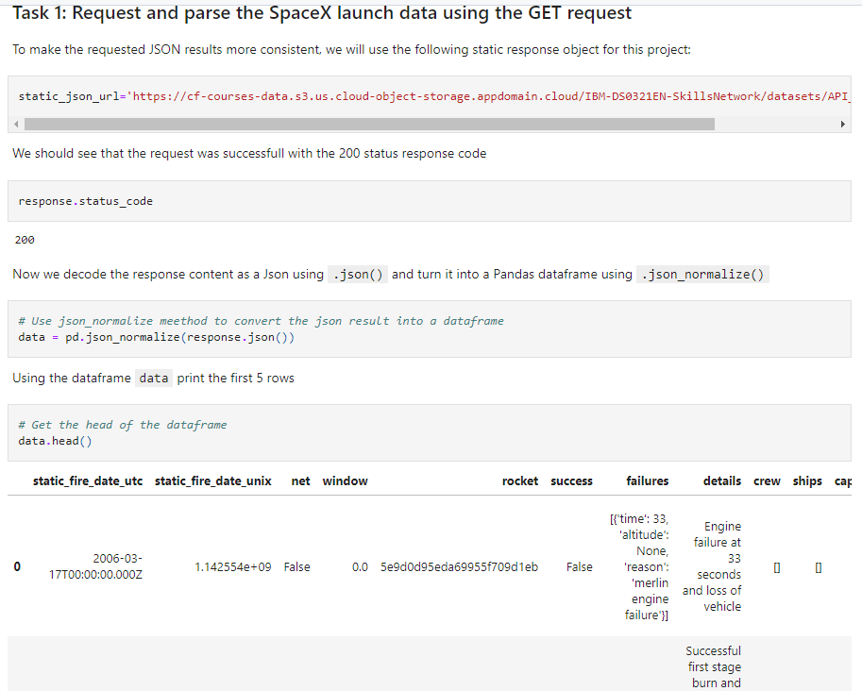
Data Collection – SpaceX API
We used the get request to the SpaceX API to collect data, clean the requested data and did some basic data wrangling and formatting.
GitHub: https://github.com/Zhdn777/future/blob/3dd30fc2eb9ead5f43fedd8ec72dc0ee8430157f/SpaceX%20api.ipynb
Place your flowchart of SpaceX API calls here

Slide 9
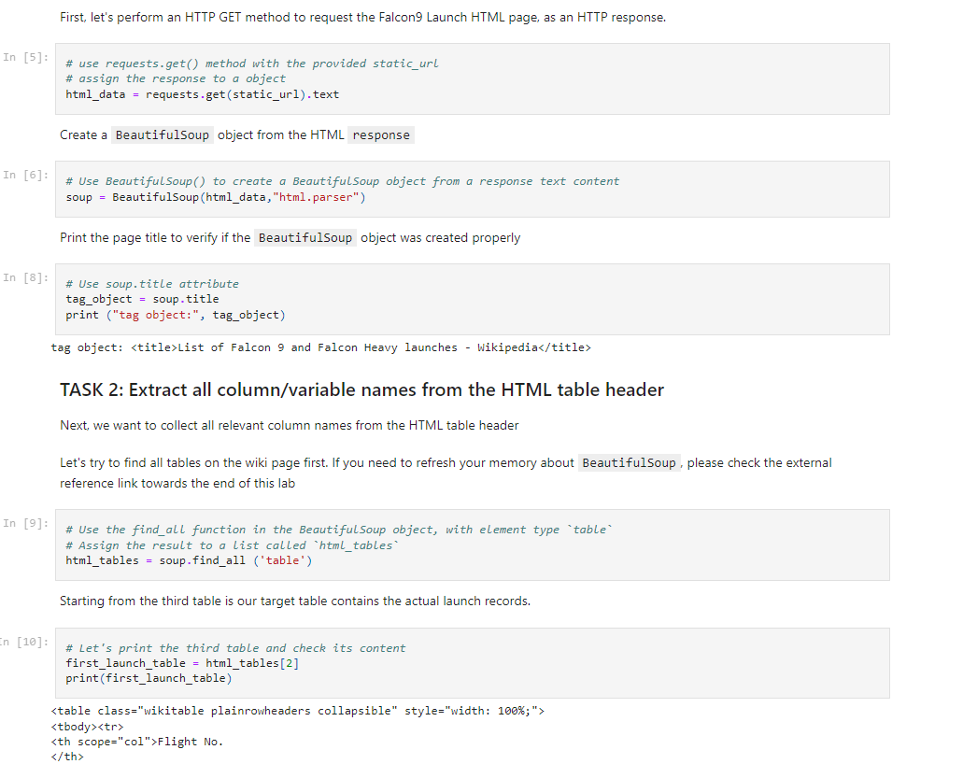
Data Collection - Scraping
We applied web scrapping to Falcon 9 launch records with BeautifulSoup
Converted table to Pandas DF.
Link to GitHub: https://github.com/Zhdn777/future/blob/3dd30fc2eb9ead5f43fedd8ec72dc0ee8430157f/Space%20X%20webscraping.ipynb
Place your flowchart of web scraping here

Slide 10
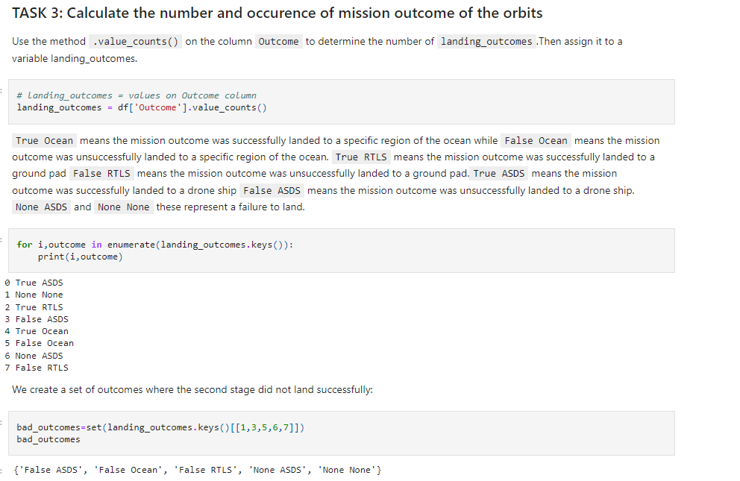
Data Wrangling
Identified the training labels by doing an exploratory data analysis.
We determined the quantity of launches at every location as well as the quantity and frequency of each orbit.
From the outcome column, we generated the landing outcome label and exported the data to CSV.
GitHub:
https://github.com/Zhdn777/future/blob/3dd30fc2eb9ead5f43fedd8ec72dc0ee8430157f/lSpace%20X%20Falcon%20-Data%20wrangling.ipynb

Slide 11
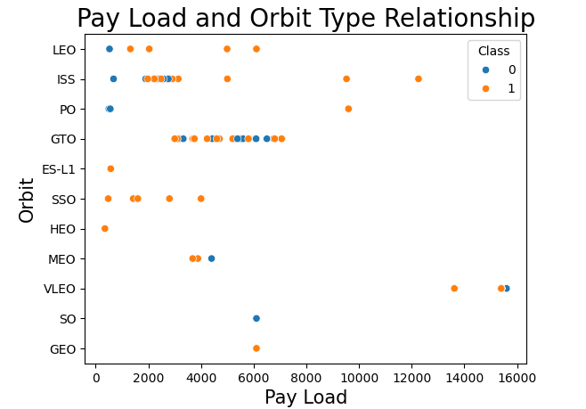
EDA with Data Visualization
For better understanding of the relationship between the flight number and the launch site, the payload and the launch site, the success rate of each orbit type, the flight number and the orbit type, and the annual trend of launch success were all visualised as we investigated the data.
GitHub: https://github.com/Zhdn777/future/blob/3dd30fc2eb9ead5f43fedd8ec72dc0ee8430157f/DATA%20Viz%20SPACE%20X.ipynb

Slide 12
EDA with SQL
Loaded the SpaceX dataset into a PostgreSQL database.
We used SQL and EDA to extract knowledge from the data. For example, we created queries to determine:
Distinct launch sites.
The total mass of payload carried
The mass of the payload that booster type F9 v1.1 typically carries
GitHub: https://github.com/Zhdn777/future/blob/3dd30fc2eb9ead5f43fedd8ec72dc0ee8430157f/SQL%20LITE%20TASK.ipynb

Slide 13
Build an Interactive Map with Folium
On the folium map, we annotated every launch site and added map elements like circles, markers, and lines to indicate the success or failure of launches for every location.
Class 0 and 1 were given the feature launch outcomes (success or failure).
that is, one for success and zero for failure.
We were able to determine which launch sites have a comparatively high success rate by using the color-labeled marker clusters.
We determined the separations between a launch site and its surrounding areas. We responded to a few inquiries, such as:
are launch locations close to highways, railroads, and coastlines.
Do launch sites maintain a specific separation from urban areas?
GitHub: https://github.com/Zhdn777/future/blob/3dd30fc2eb9ead5f43fedd8ec72dc0ee8430157f/Launch%20Sites%20Locations%20Analysis%20with%20Folium.ipynb

Slide 14
Build a Dashboard with Plotly Dash
Using Plotly dash, we constructed an interactive dashboard.
To visualize the total launches by a specific site, we created pie charts.
For each booster version, we created a scatter graph that displayed the relationship between the outcome and payload mass (kg).
GitHub: https://github.com/Zhdn777/future/blob/843e16c13af870f8a4d7cab9124b720456cdeadf/Plotly_final.ipynb

Slide 15
Predictive Analysis (Classification)
Using pandas and numpy, we loaded the data, transformed it, and divided it into training and testing sets.
Using GridSearchCV, we constructed several machine learning models and adjusted various hyperparameters.
Our model's accuracy served as its metric, and it was enhanced through feature engineering and algorithm tuning.
The top-performing classification model has been identified.
GitHub:
https://github.com/Zhdn777/future/blob/c4ab2b4d00dc2626c996f96cb6ec99a828e324cd/SpaceX_Machine_Learning_Prediction.ipynb

Slide 16
Results
Exploratory data analysis results
Interactive analytics demo in screenshots
Predictive analysis results

Slide 17

Section 2

Slide 18

Flight Number vs. Launch Site
We deduced from the plot that a launch site's success rate increases with the number of flights conducted there.

Slide 19
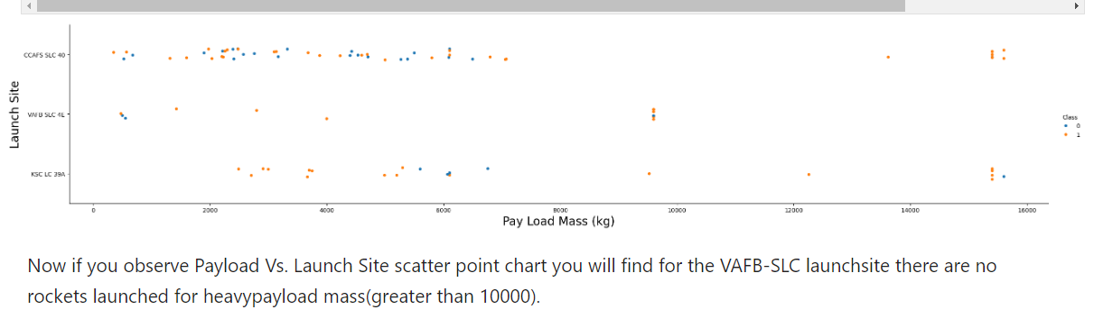
Payload vs. Launch Site

Slide 20
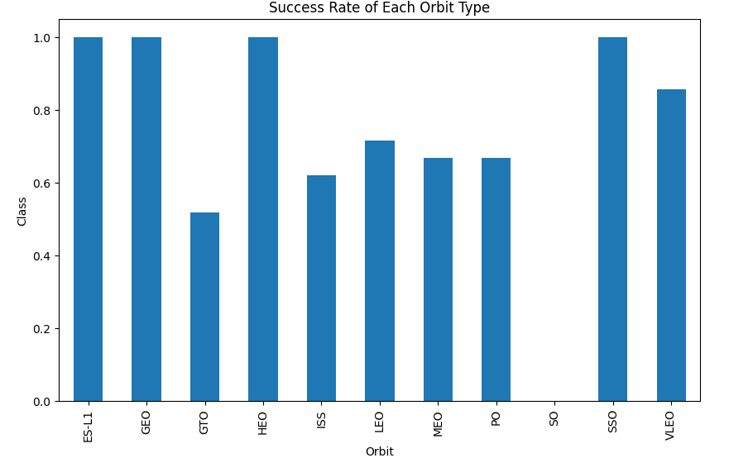
Success Rate vs. Orbit Type
ES-L1, GEO, HEO, SSO, VLEO had the most success rate. explanations

Slide 21
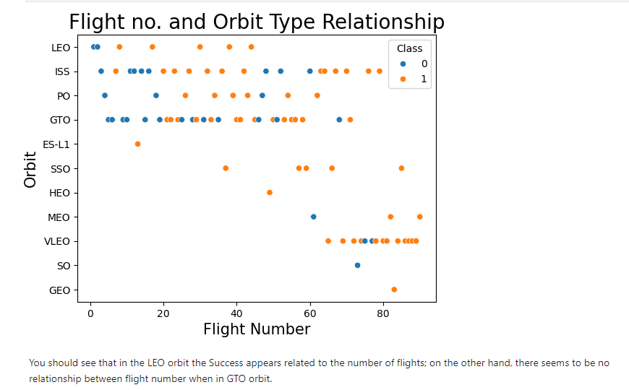
Flight Number vs. Orbit Type

Slide 22
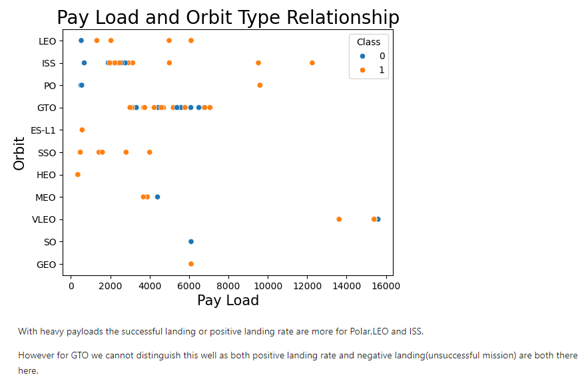
Payload vs. Orbit Type

Slide 23
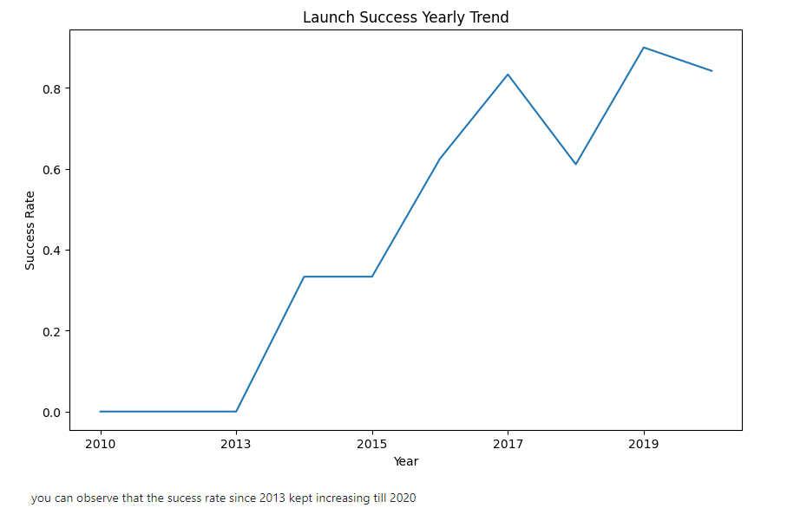
Launch Success Yearly Trend

Slide 24
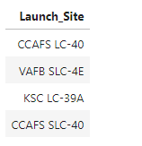
All Launch Site Names
Used the Distinct function to find all unique Site Names

Slide 25
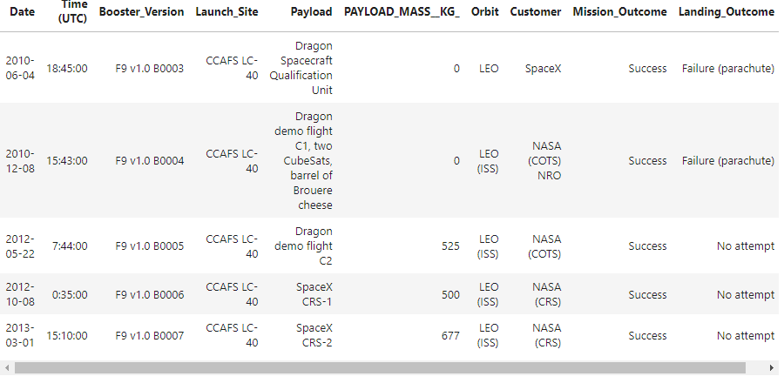
Launch Site Names Begin with 'CCA'
Querried 5 Site Names that were starting with “CCA” with the “%” method.
Present your query result with a short explanation here

Slide 26
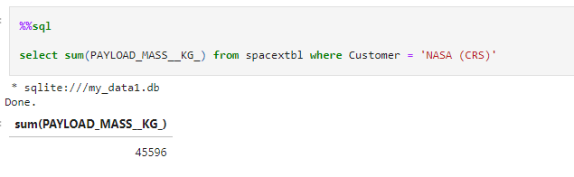
Total Payload Mass
Calculated the Total Payload Mass with the following query:

Slide 27
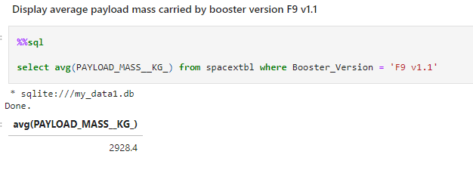
Average Payload Mass by F9 v1.1
Calculated Average Payload with the following querry:

Slide 28
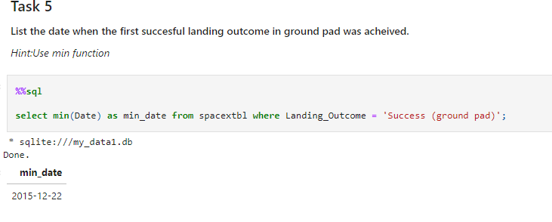
First Successful Ground Landing Date
Found first successful landing with following querry:

Slide 29
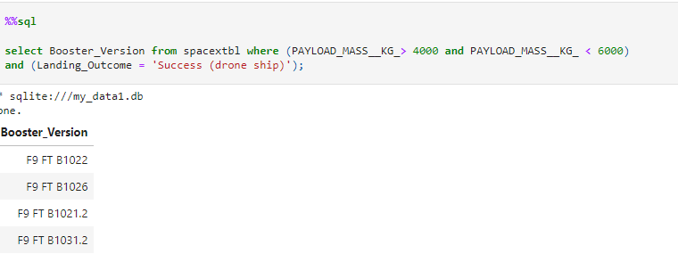
Successful Drone Ship Landing with Payload between 4000 and 6000
List the names of boosters which have successfully landed on drone ship and had payload mass greater than 4000 but less than 6000
Used the following query to get the result.

Slide 30
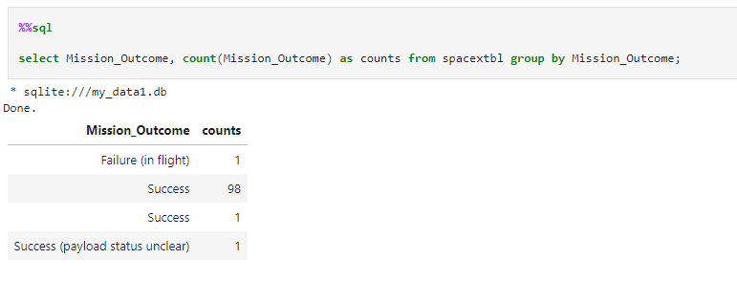
Total Number of Successful and Failure Mission Outcomes
Calculated the total number of successful and failure mission outcomes with Group by.

Slide 31
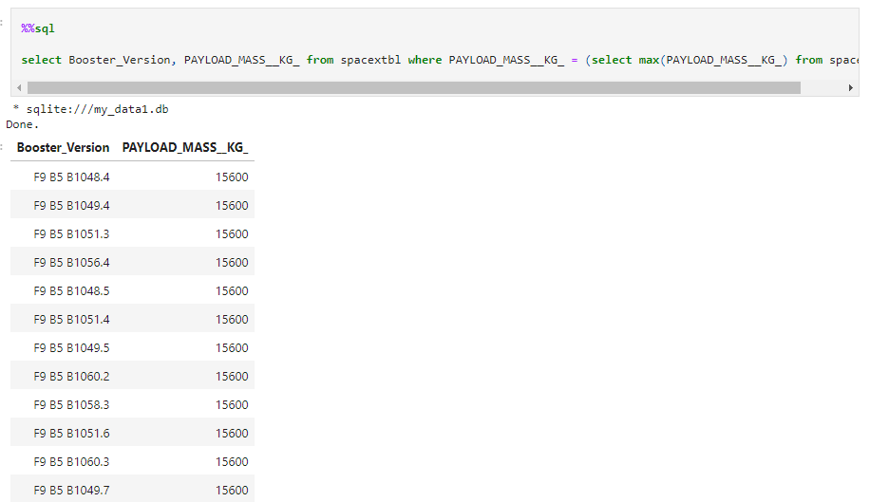
Boosters Carried Maximum Payload
List the names of the booster which have carried the maximum payload mass
with a subquery

Slide 32
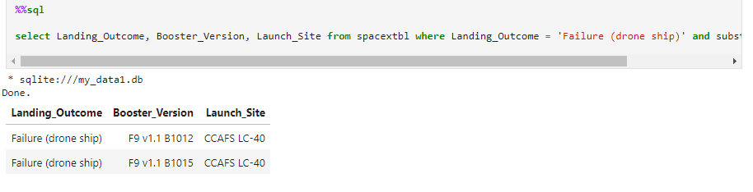
2015 Launch Records
Found the failed landing_outcomes in drone ship, their booster versions, and launch site names for in year 2015.
Used substr(Date,0,5)=‚2015’ to filter the date.

Slide 33
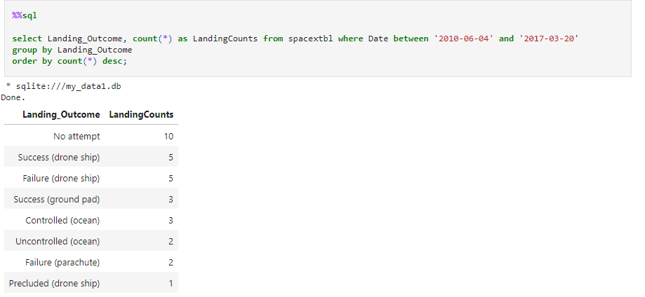
Rank Landing Outcomes Between 2010-06-04 and 2017-03-20
Ranked the count of landing outcomes (such as Failure (drone ship) or Success (ground pad)) between the date 2010-06-04 and 2017-03-20, in descending order

Slide 34

Section 3

Slide 35
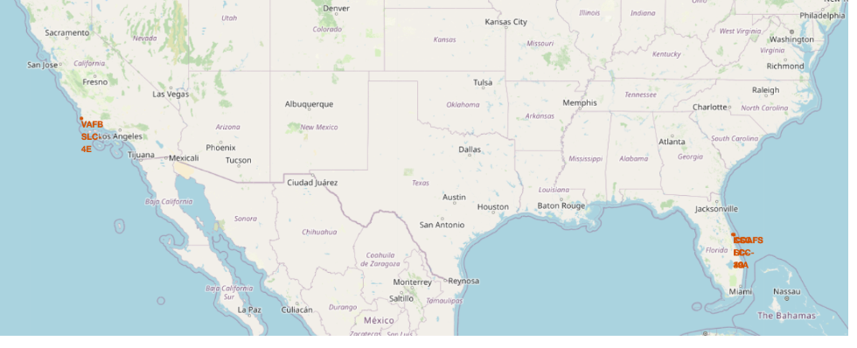
Space X Launch Sites
Replace <Folium map screenshot 1> title with an appropriate title
Explore the generated folium map and make a proper screenshot to include all launch sites’ location markers on a global map
Explain the important elements and findings on the screenshot

Slide 36

Color Markers showing launching outcomes
Replace <Folium map screenshot 2> title with an appropriate title
Explore the folium map and make a proper screenshot to show the color-labeled launch outcomes on the map
Explain the important elements and findings on the screenshot

Slide 37
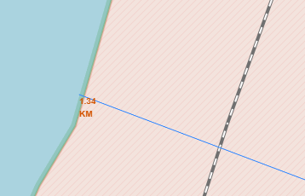
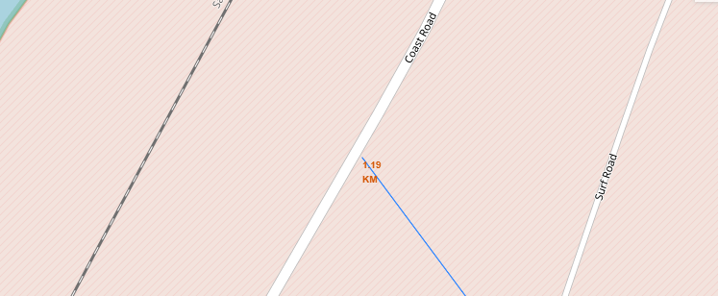
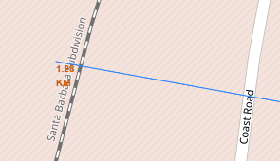
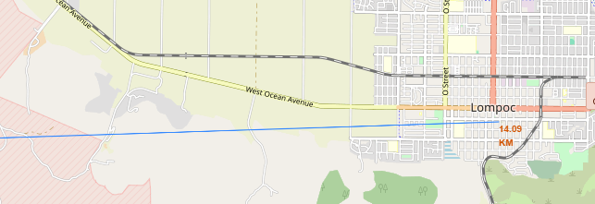
Launch Site distance to landmarks
Distance to coastline
Distance to highway
Distance to railway
Distance to city

Slide 38

Section 4

Slide 39
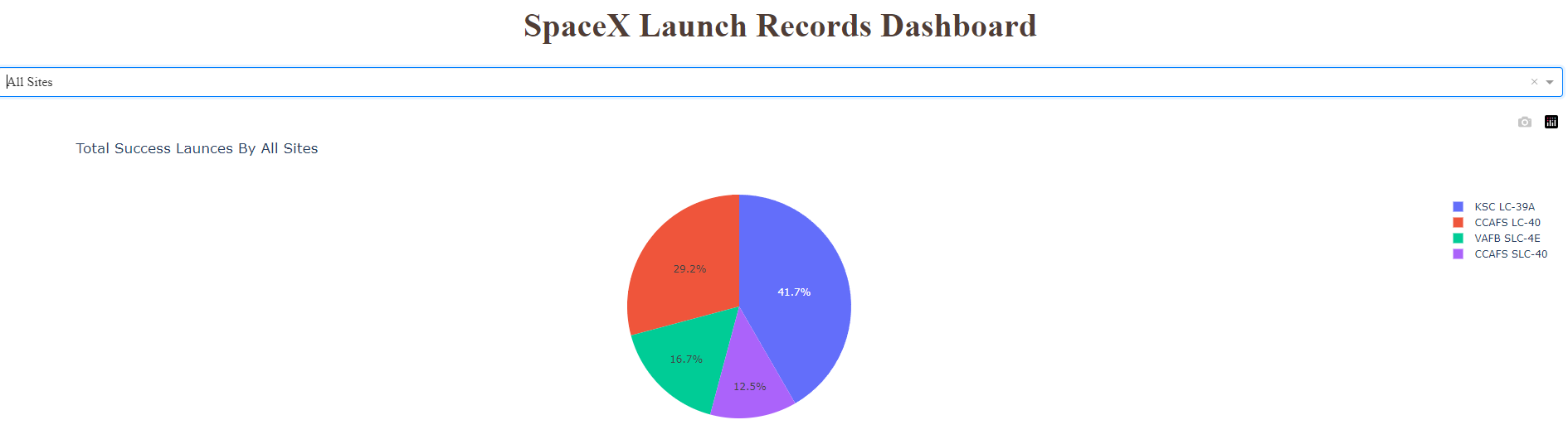
% of successful launches
KSC LC- 39A had the biggest share of successful launches

Slide 40
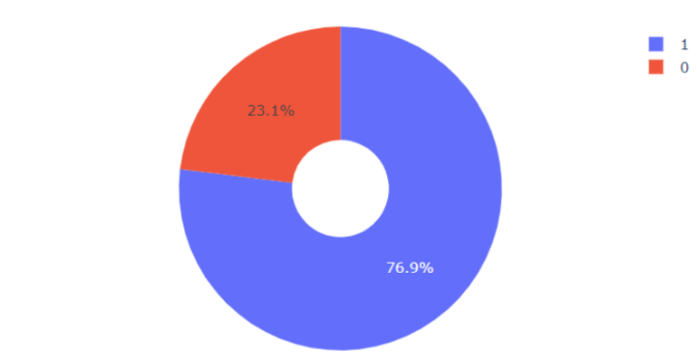
Success rate of the top performer in %
KSC LC 39-A had an success rate of 76.9% and failed 23.1% of the time

Slide 41
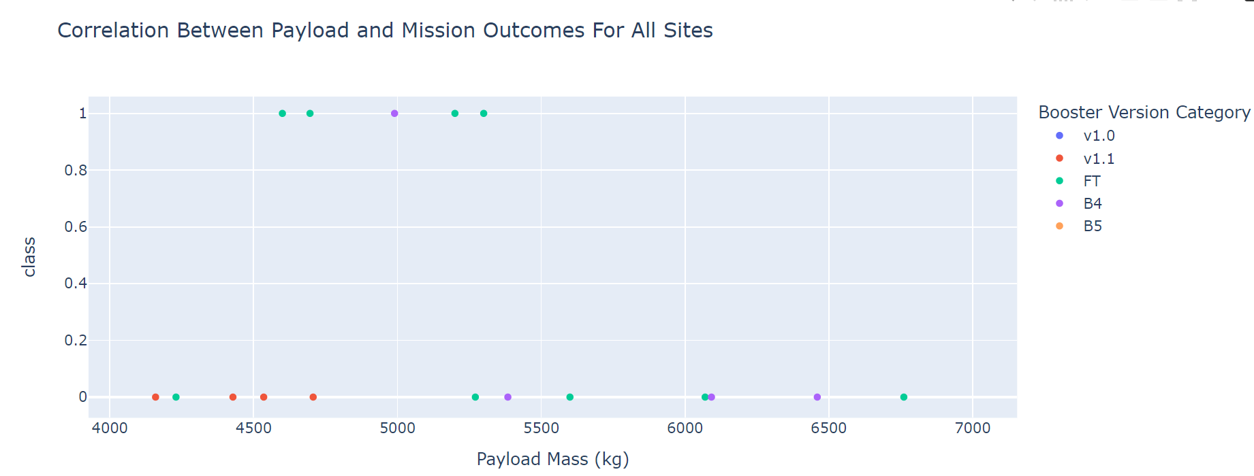
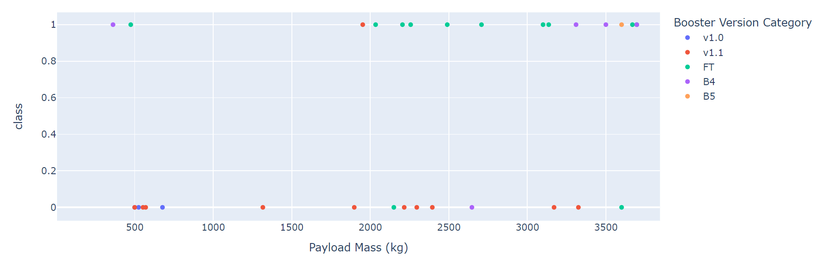
Scatter plot of Payload vs Launch Outcome for all sites, with different payload
Payload from 0 to 4000kg
Payload above 4000kg
From the visualtion can be determined that low weighted Payload had bigger success than the heavy weighted.

Slide 42

Section 5

Slide 43
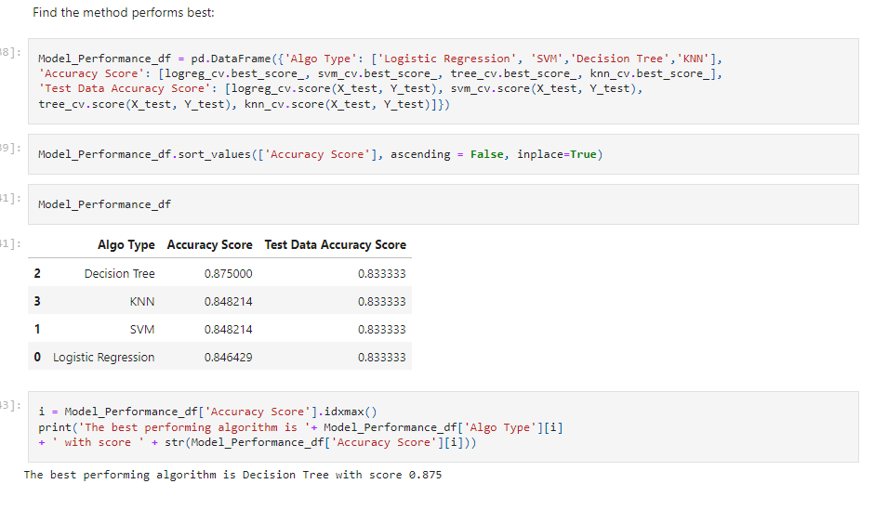
Classification Accuracy
The decision tree classifier is the model with the highest classification accuracy

Slide 44
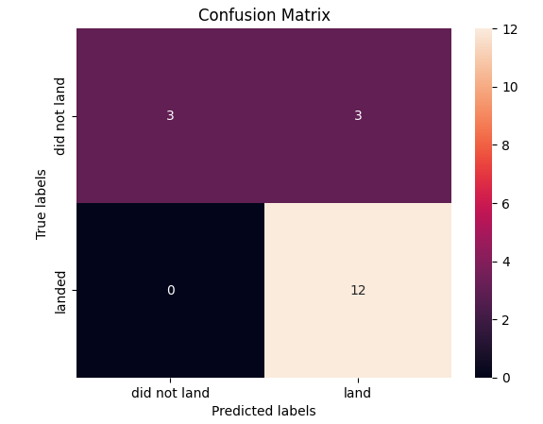
Confusion Matrix
The decision tree classifier's confusion matrix demonstrates the classifier's ability to discriminate between the various classes. False positives are the main issue. i.e., the classifier interprets an unsuccessful landing as a successful landing.

Slide 45
Conclusions
We can draw the following conclusion: A launch site's success rate increases with the number of flights conducted there.
The launch success rate increased from 2013 to 2020.
Orbits with the highest success rate were ES-L1, GEO, HEO, SSO, and VLEO.
Out of all the sites, KSC LC-39A had the most successful launches.
The most effective machine learning algorithm for this task is the decision tree classifier.

Slide 46


